Slide 1
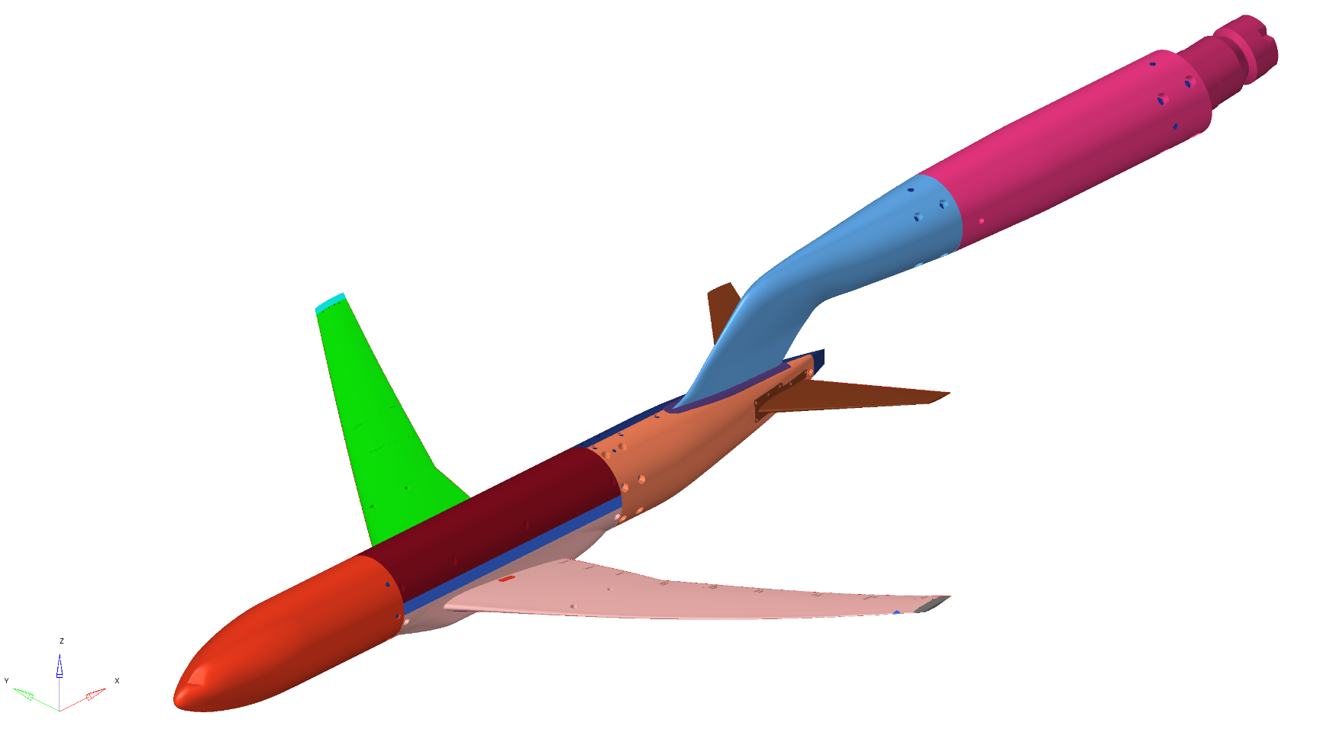
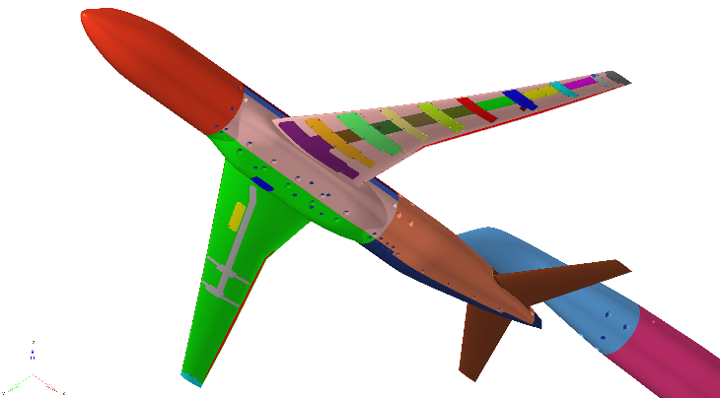
Solver : MSC Nastran Eigenvalue (SOL 103)
Node : 1,447,238 nodes
Element : 6,296,514 elements
Material | Elastic (MPa) | Poisson ν | Density (ton/mm³)
SUS630 | 196000.0 | 0.272 | 7.78×10⁻⁹
Devcon | 5830.0 | 0.350 | 2.30×10⁻⁹
Constraint
x,y,z translation
X,y,z rotation
FEM model
wing side view

Slide 2
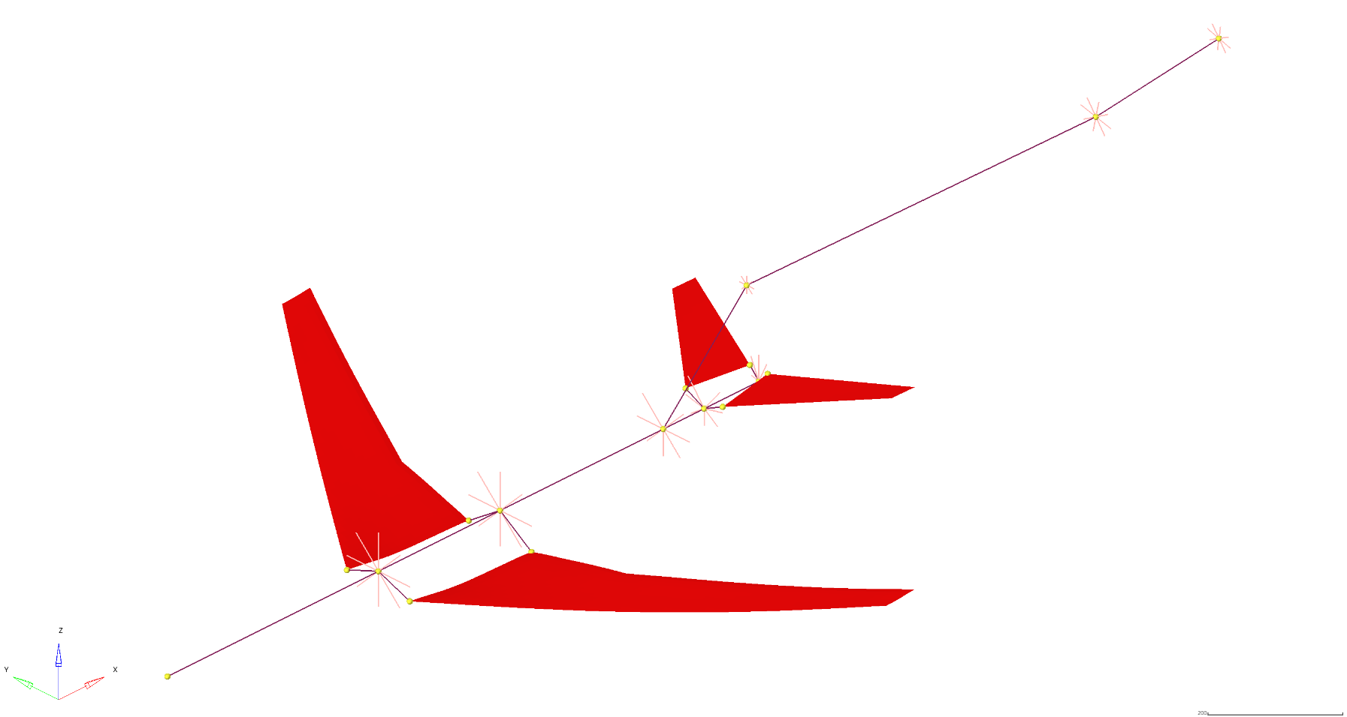
Element for post process : 1,418 elements
(Shell = 1,394 , RBE3 = 8 , BEAM = 16)
Material | Elastic (MPa) | Poisson ν | Density (ton/mm³)
Dummy | 1.0 | 0.3 | -
Dummy Shell thickness = 0.1
Dummy Beam type = ROD , r = 1.0
Shell Element for Post Process

Slide 3
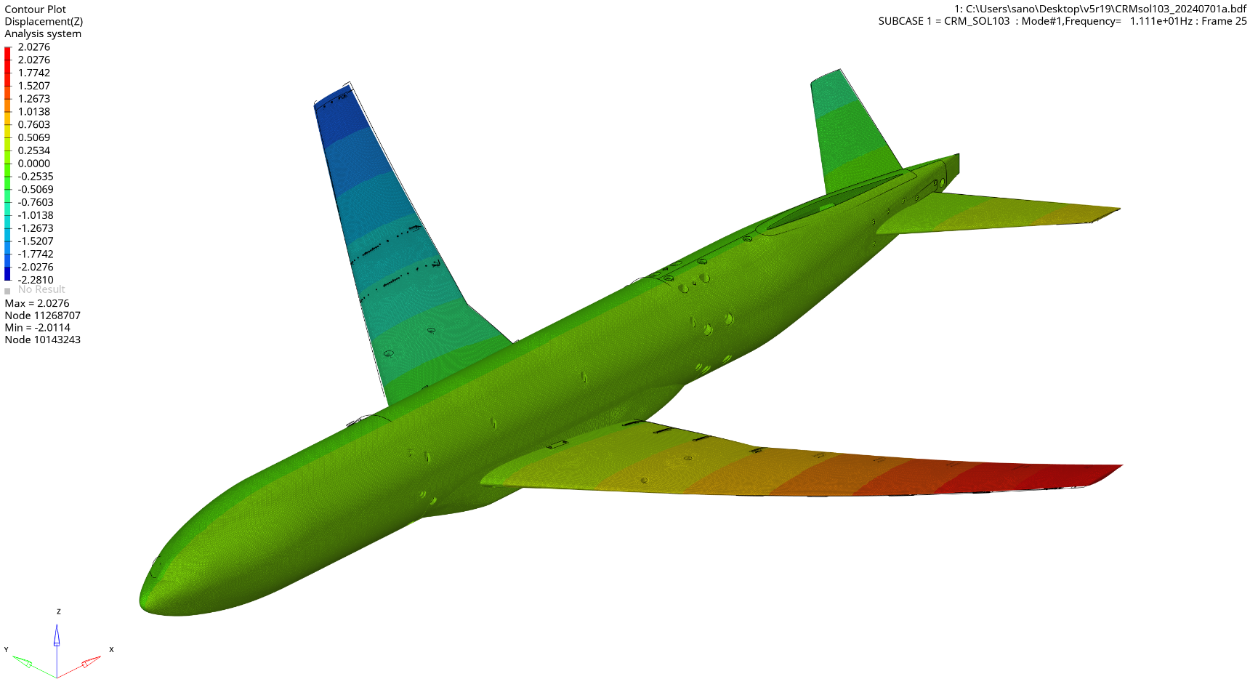
Deformation : ×1.0
MODE 1 Z-direction Deformation (11.11Hz)

Slide 4
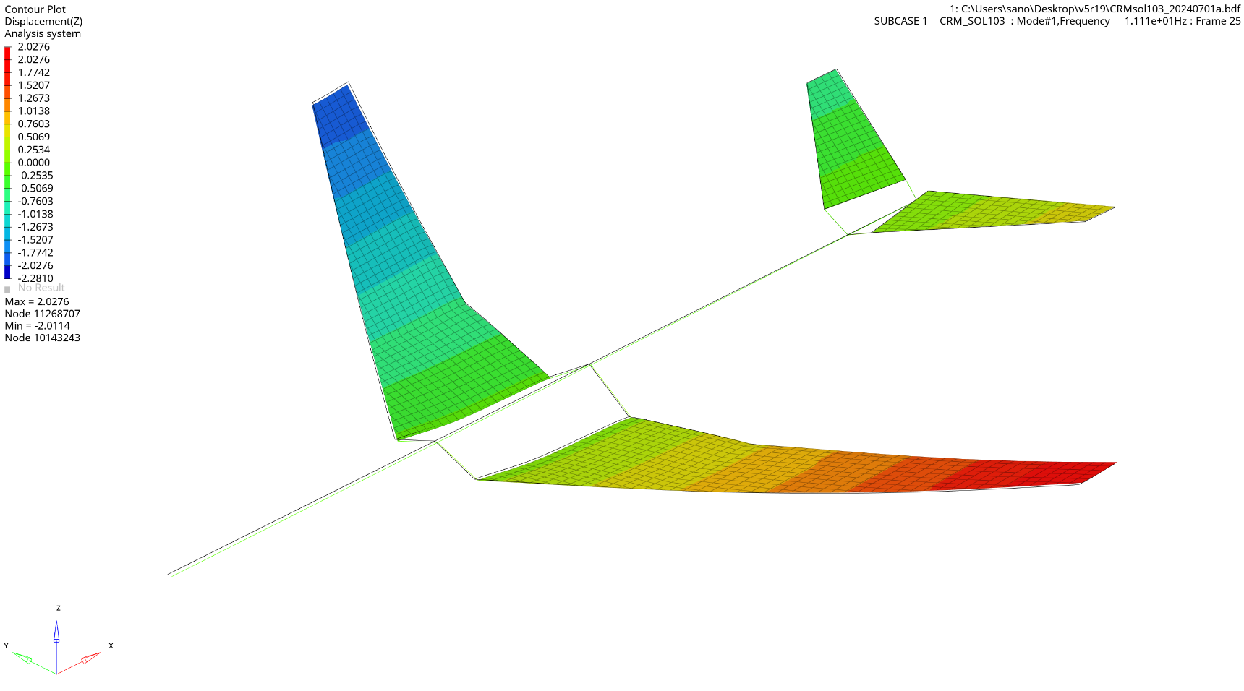
Deformation : ×1.0
MODE 1 Z-direction Deformation (11.11Hz)

Slide 5
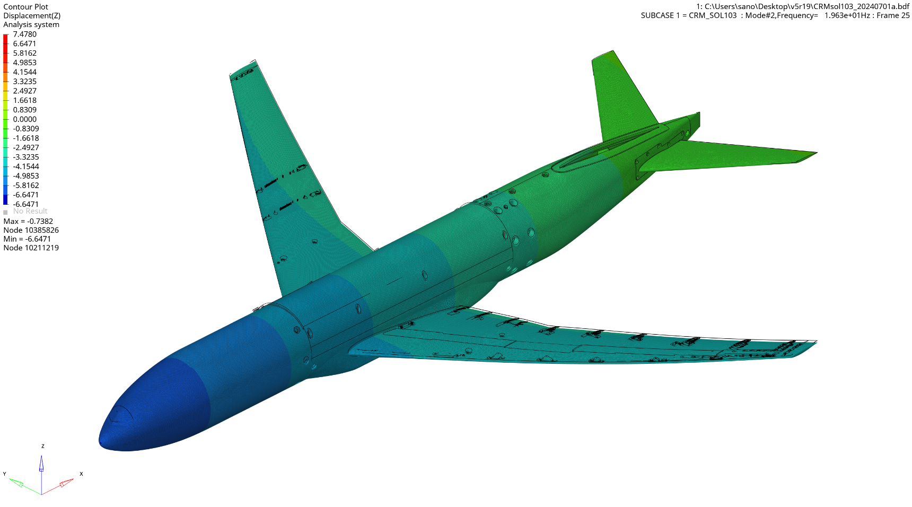
Deformation : ×1.0
MODE 2 Z-direction Deformation (19.63Hz)

Slide 6
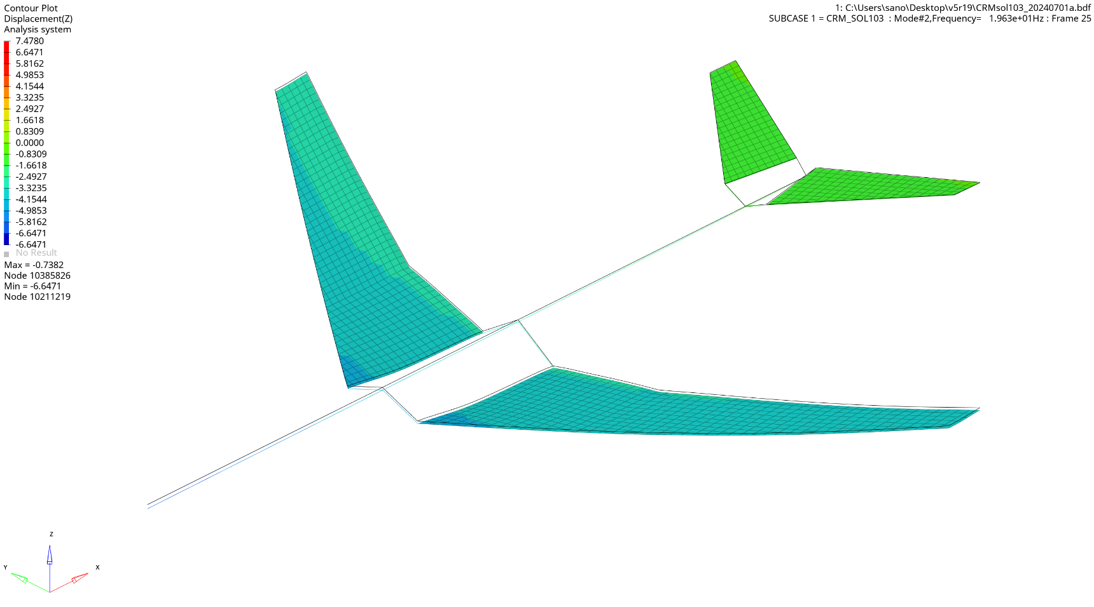
Deformation : ×1.0
MODE 2 Z-direction Deformation (19.63Hz)

Slide 7
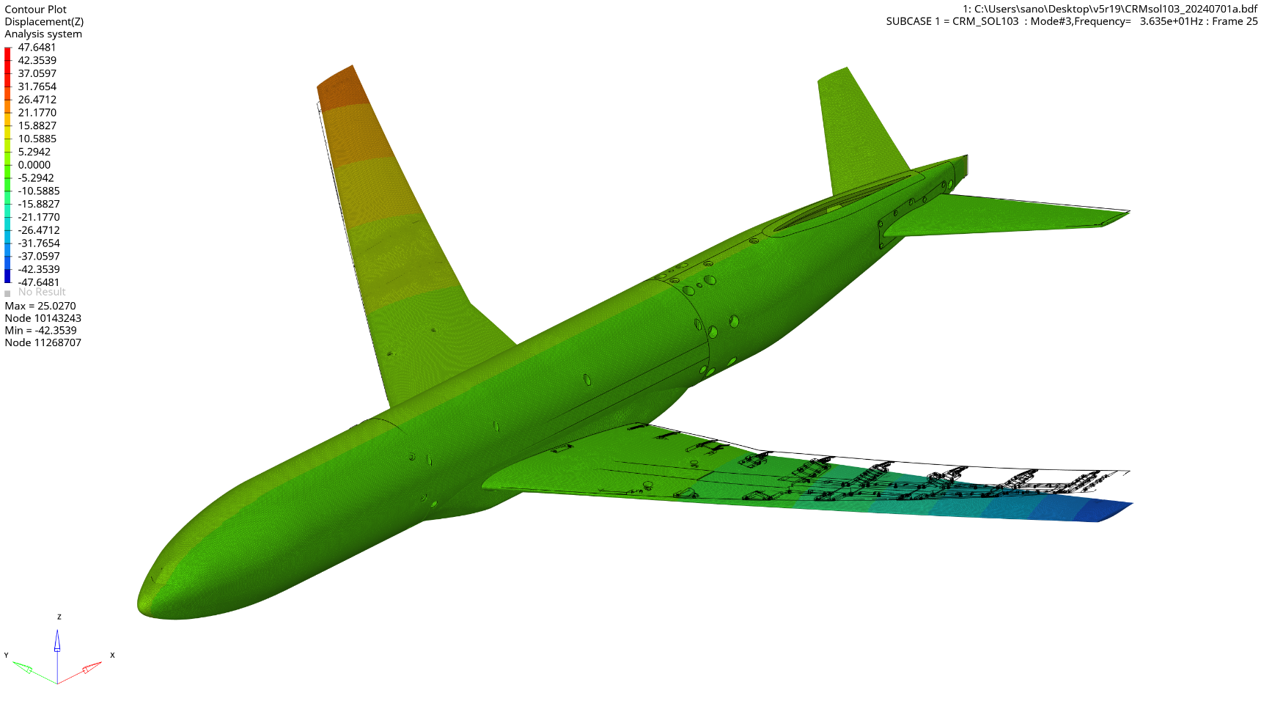
Deformation : ×1.0
MODE 3 Z-direction Deformation (36.35Hz)

Slide 8
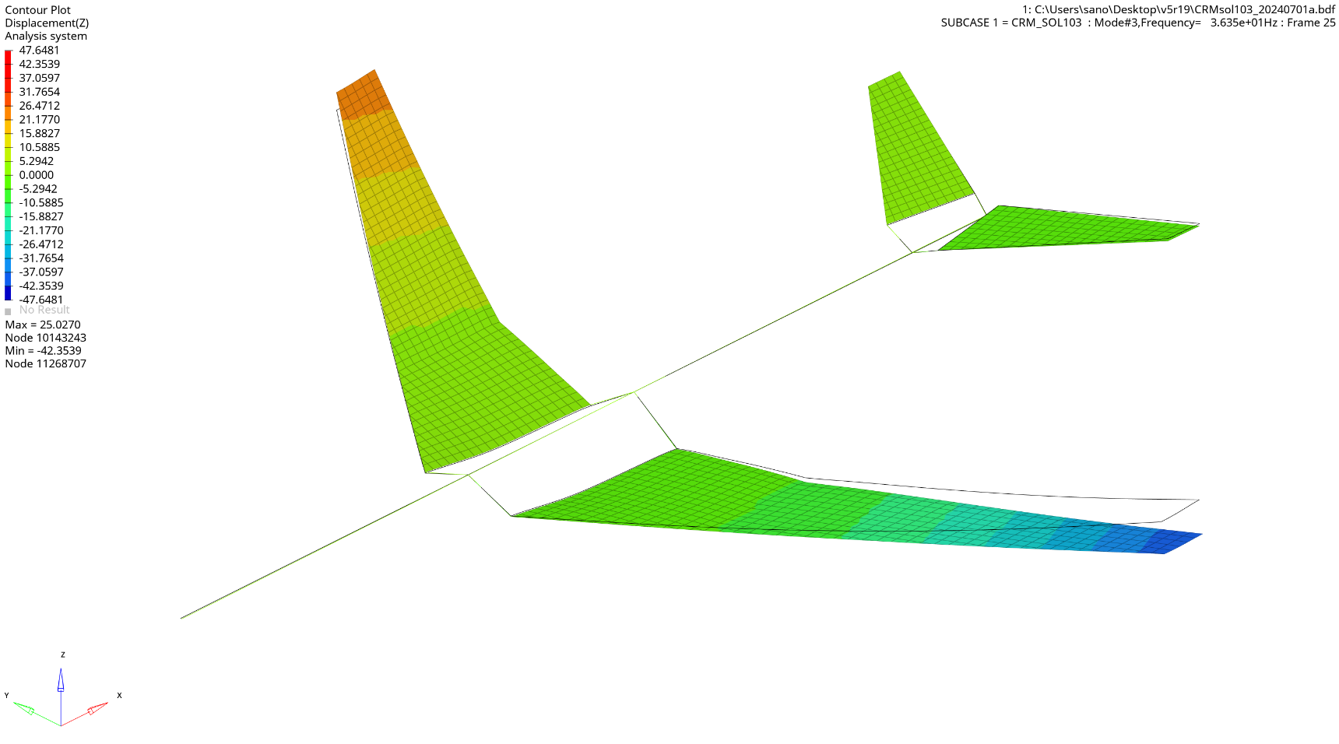
Deformation : ×1.0
MODE 3 Z-direction Deformation (36.35Hz)

Slide 9
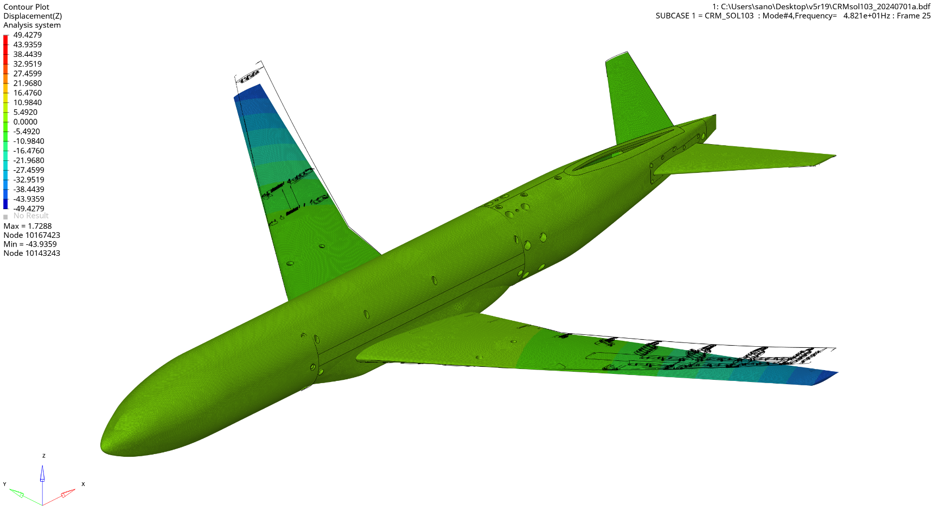
Deformation : ×1.0
MODE 4 Z-direction Deformation (48.21Hz)

Slide 10
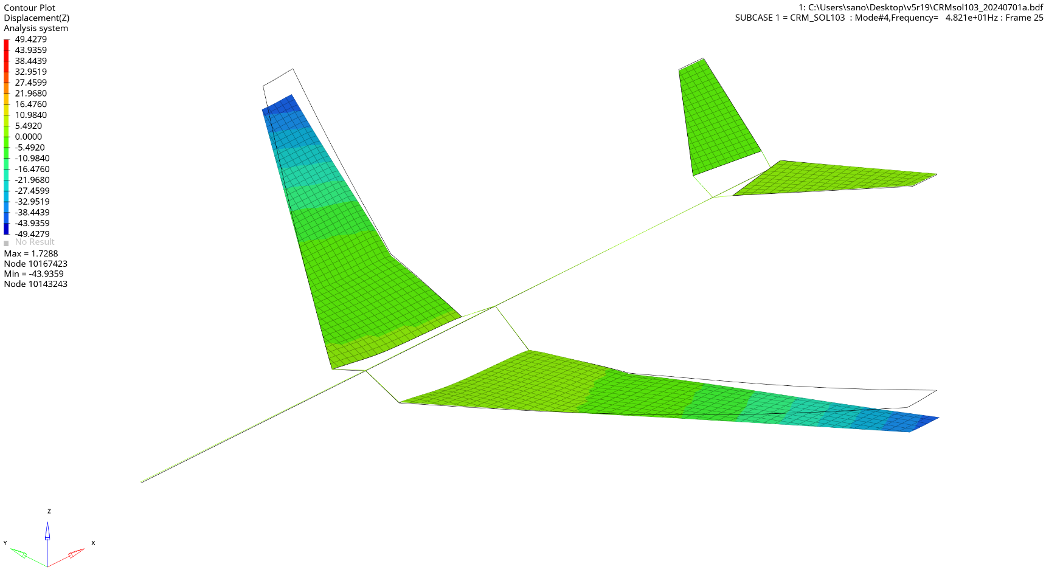
Deformation : ×1.0
MODE 4 Z-direction Deformation (48.21Hz)

Slide 11
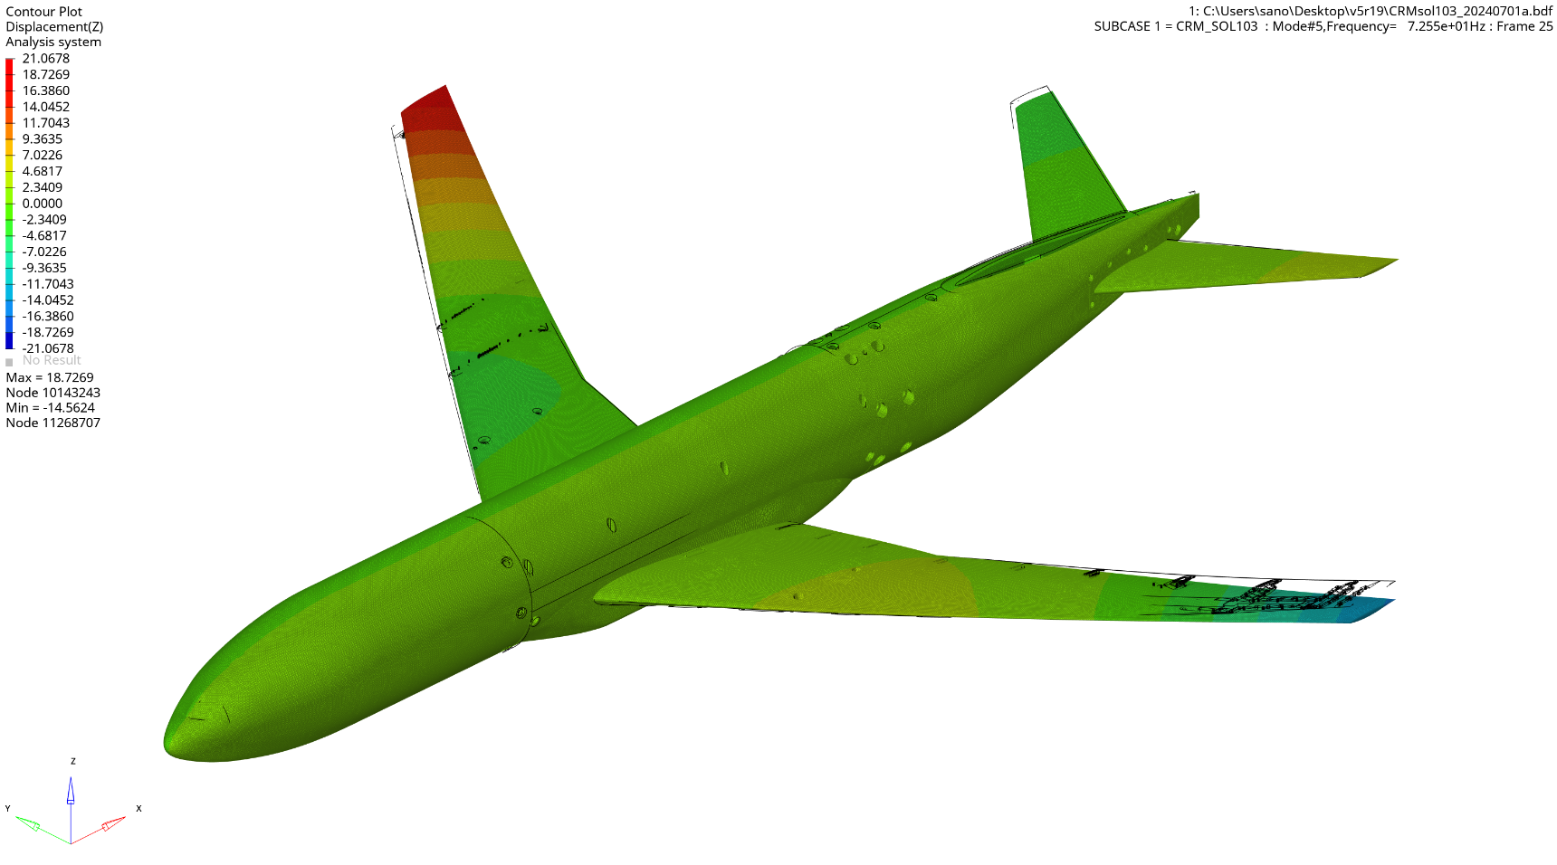
Deformation : ×1.0
MODE 5 Z-direction Deformation (72.55Hz)

Slide 12
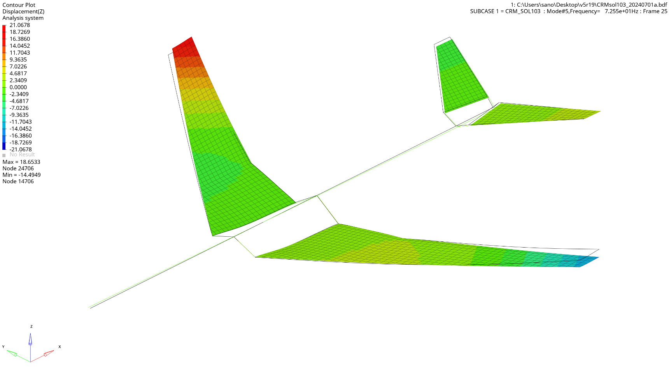
Deformation : ×1.0
MODE 5 Z-direction Deformation (72.55Hz)

Slide 13
Deformation : ×1.0
MODE 6 Z-direction Deformation (91.40Hz)

Slide 14
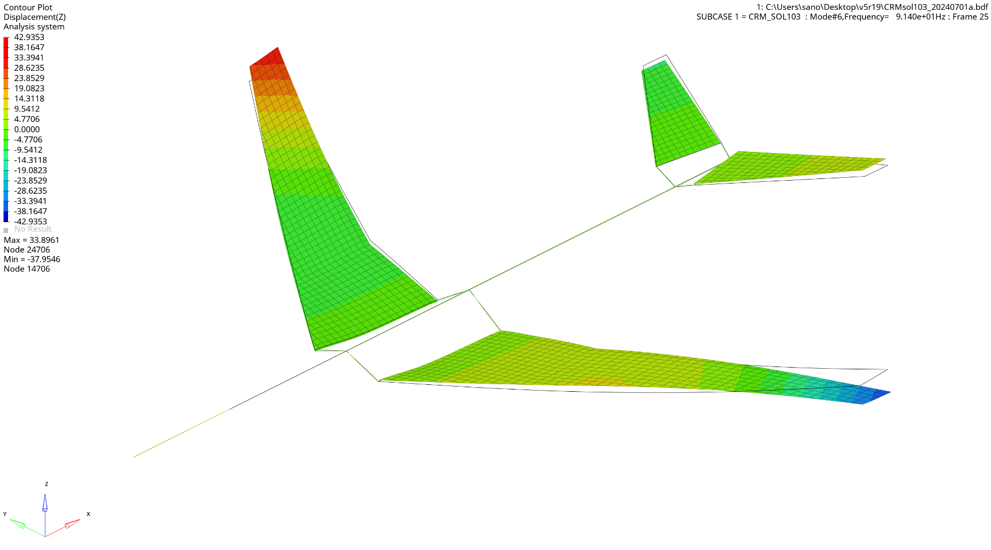
Deformation : ×1.0
MODE 6 Z-direction Deformation (91.40Hz)

Slide 15
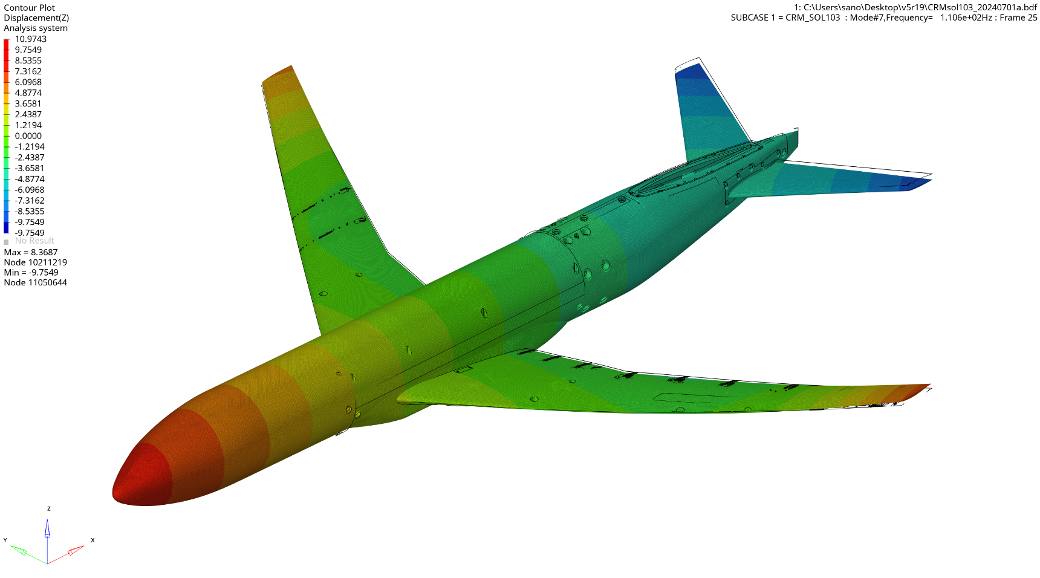
Deformation : ×1.0
MODE 7 Z-direction Deformation (110.56Hz)

Slide 16
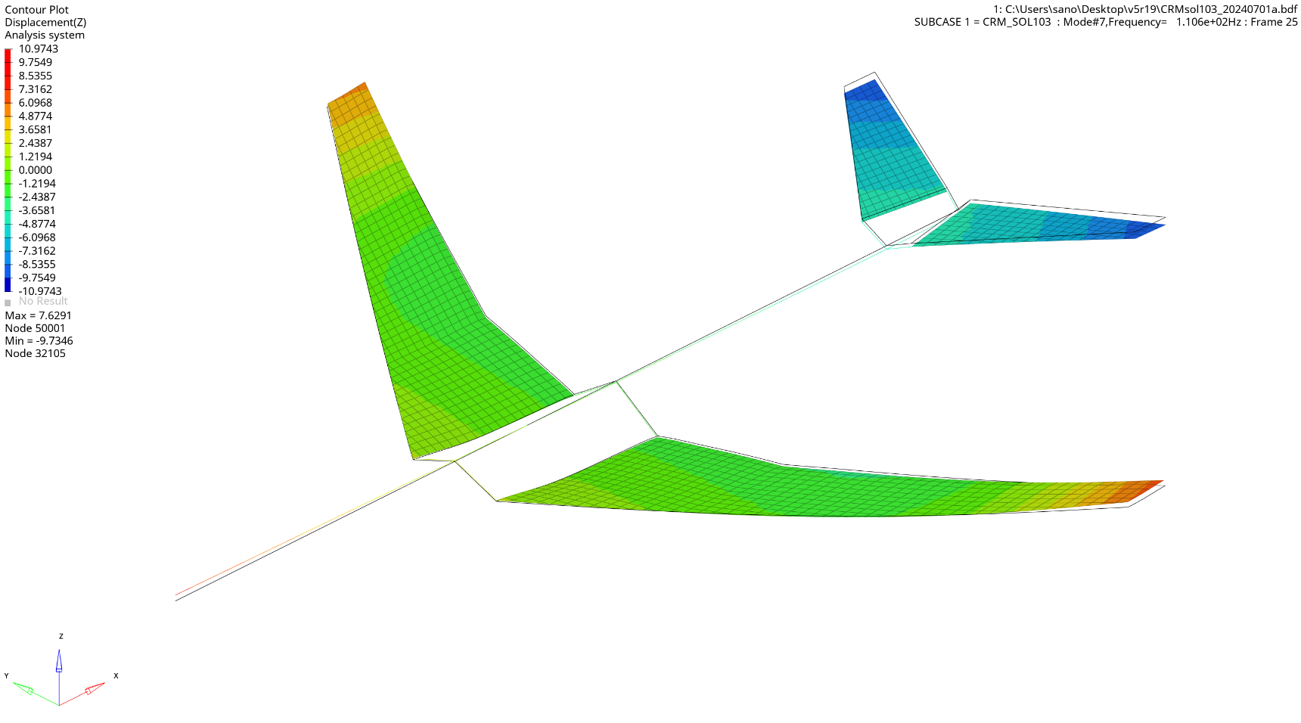
Deformation : ×1.0
MODE 7 Z-direction Deformation (110.56Hz)

Slide 17
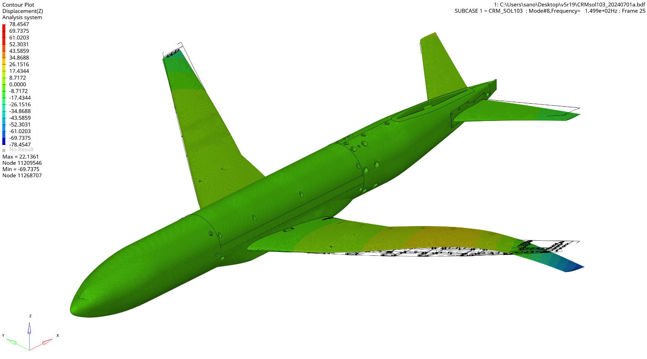
Deformation : ×1.0
MODE 8 Z-direction Deformation (149.91Hz)

Slide 18
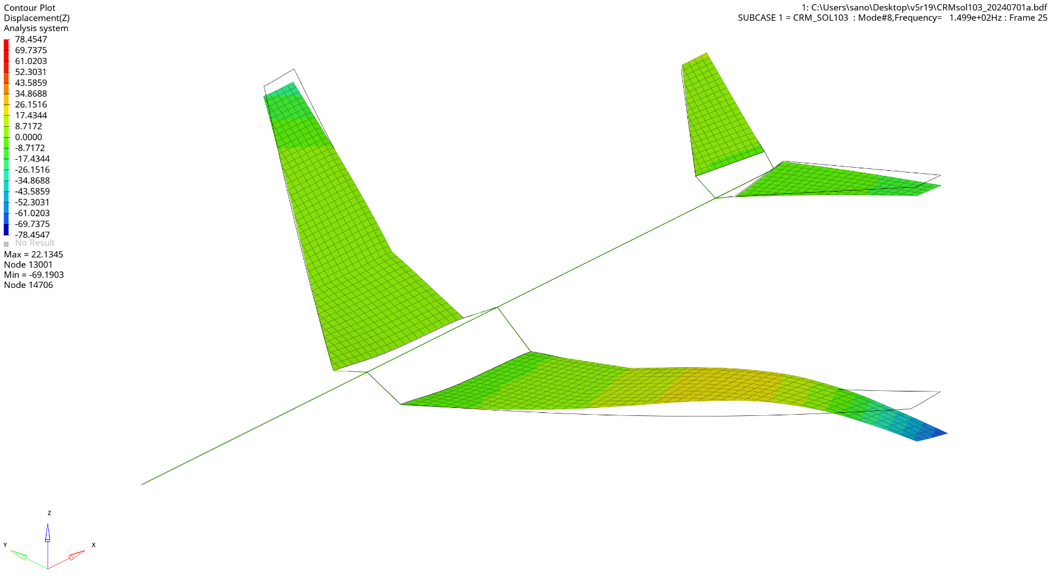
Deformation : ×1.0
MODE 8 Z-direction Deformation (149.91Hz)

Slide 19
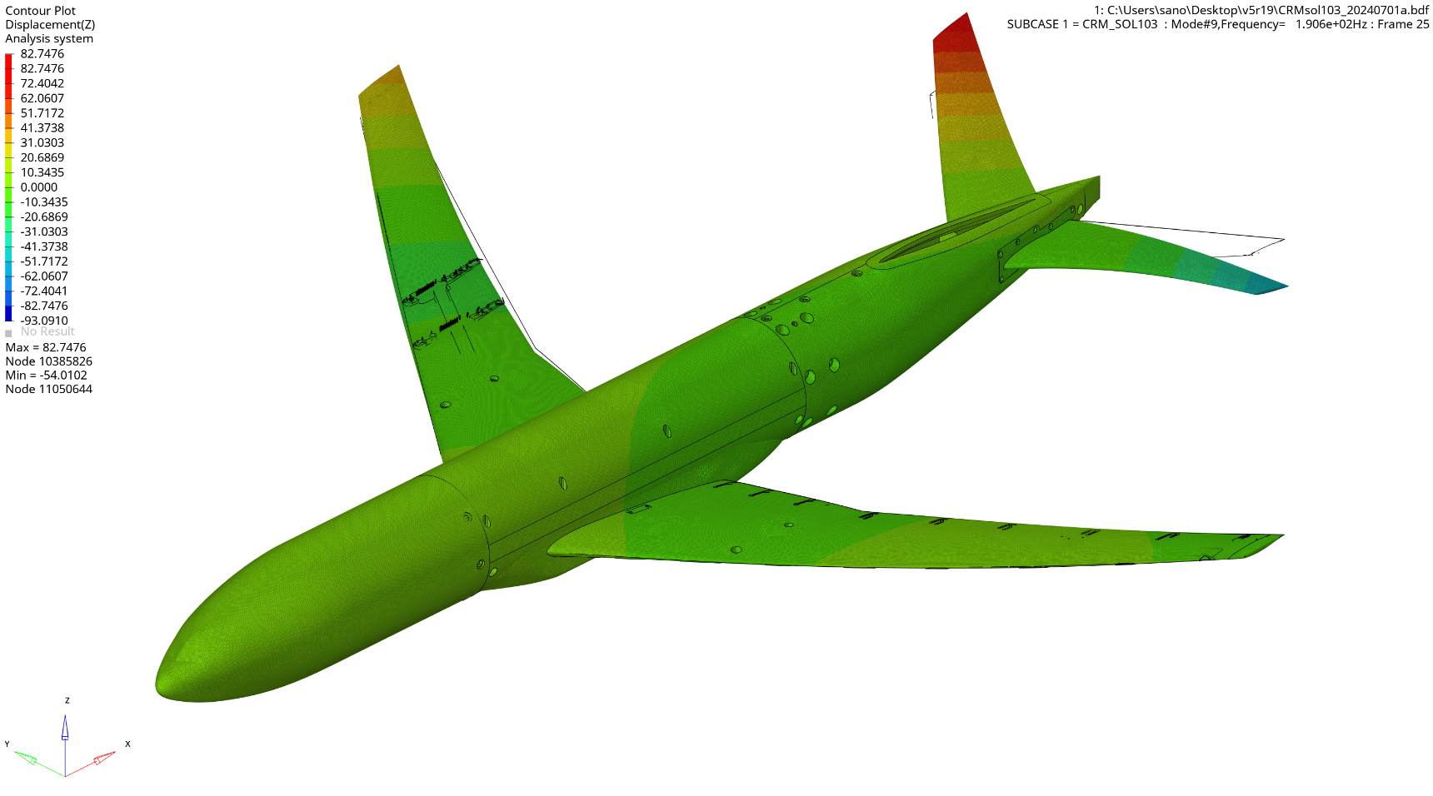
Deformation : ×1.0
MODE 9 Z-direction Deformation (190.61Hz)

Slide 20
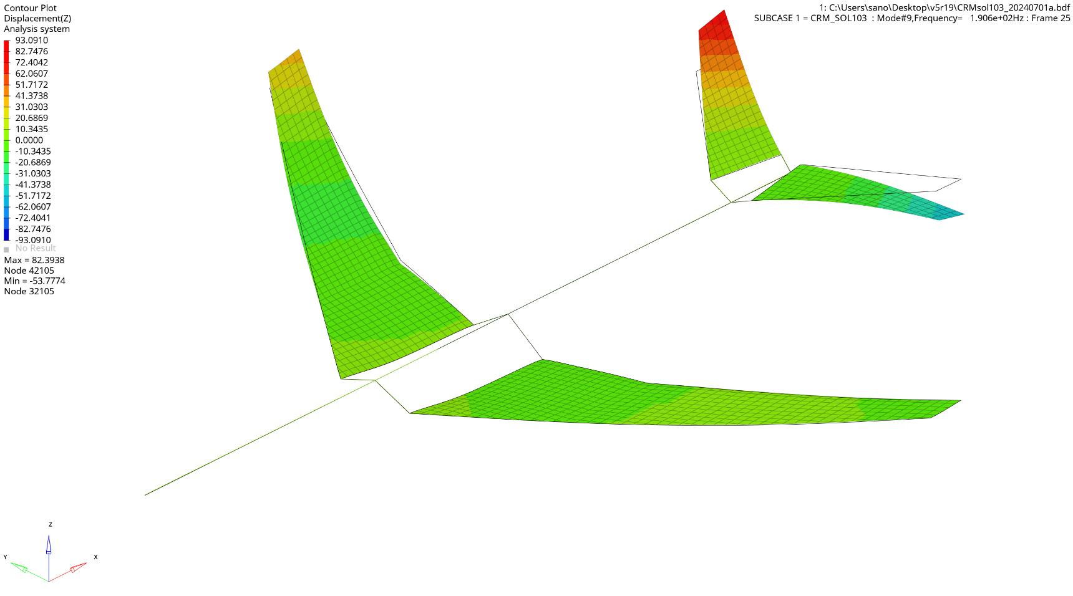
Deformation : ×1.0
MODE 9 Z-direction Deformation (190.61Hz)

Slide 21
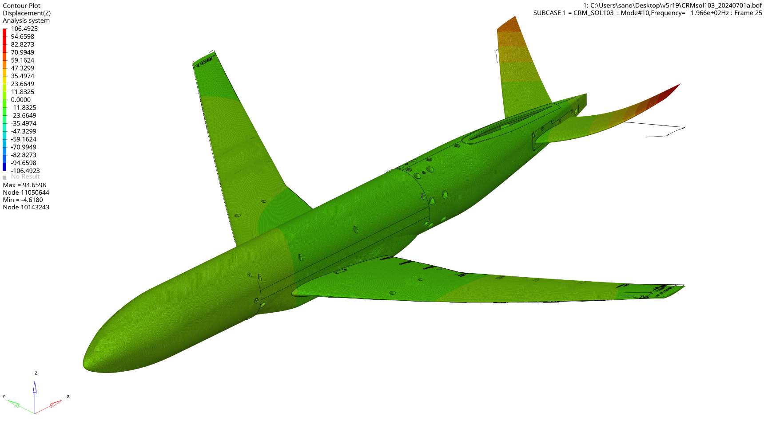
Deformation : ×1.0
MODE 10 Z-direction Deformation (196.56Hz)

Slide 22
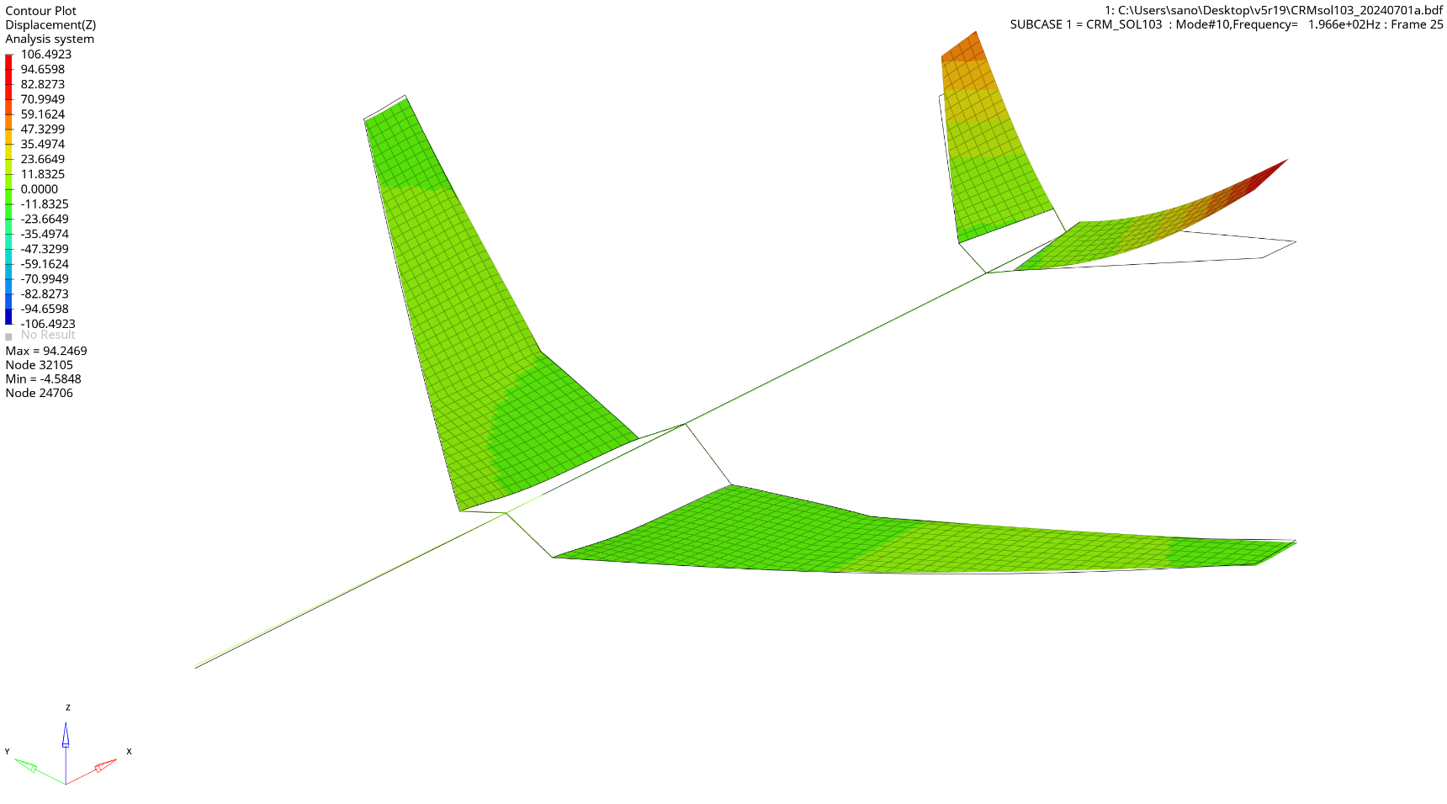
Deformation : ×1.0
MODE 10 Z-direction Deformation (196.56Hz)

