Slide 1
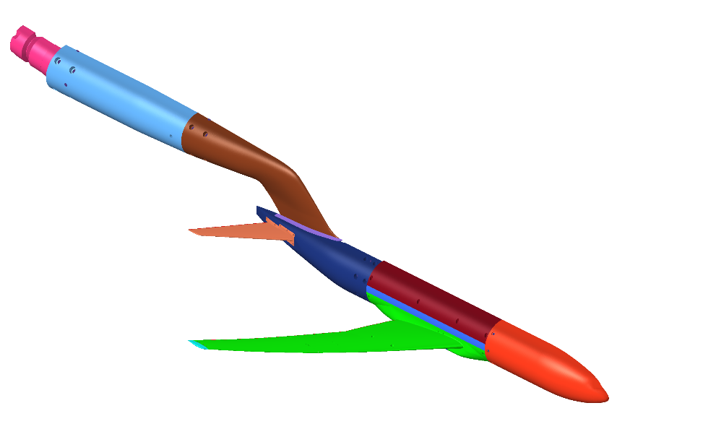
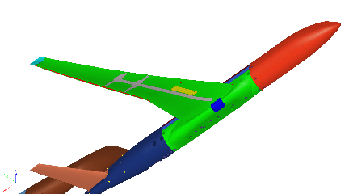
Solver : MSC Nastran Eigenvalue (SOL 103)
Material | Elastic (MPa) | Poisson ν | Density (ton/mm³)
SUS630 | 196000.0 | 0.272 | 7.78×10⁻⁹
Devcon | 5830.0 | 0.350 | 2.30×10⁻⁹
FEM model

Slide 2
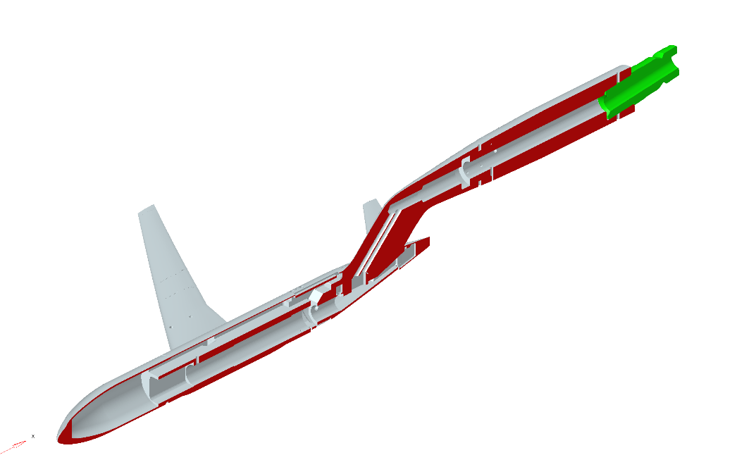
Constraint
x,y,z translation
x,y,z rotation
Constraint
y translation
x,z rotation
FEM model

Slide 3
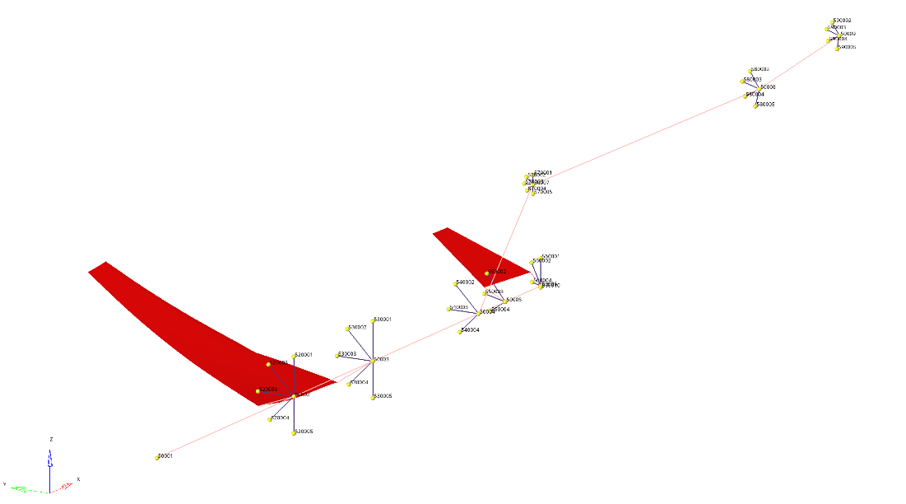
Material | Elastic (MPa) | Poisson ν | Density (ton/mm³)
Dummy | 1.0 | 0.3 | -
Dummy Shell thickness = 0.1
Dummy Beam type = ROD , r = 1.0
Shell Element for Post Process

Slide 4
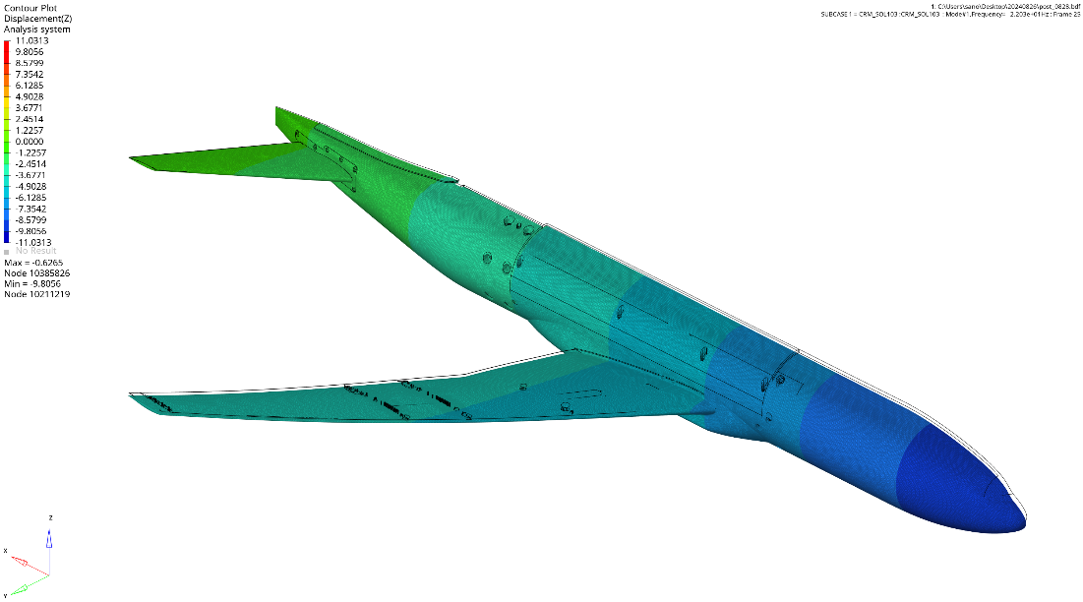
Deformation : ×1.0
MODE 1 Z-direction Deformation (22.03Hz)

Slide 5
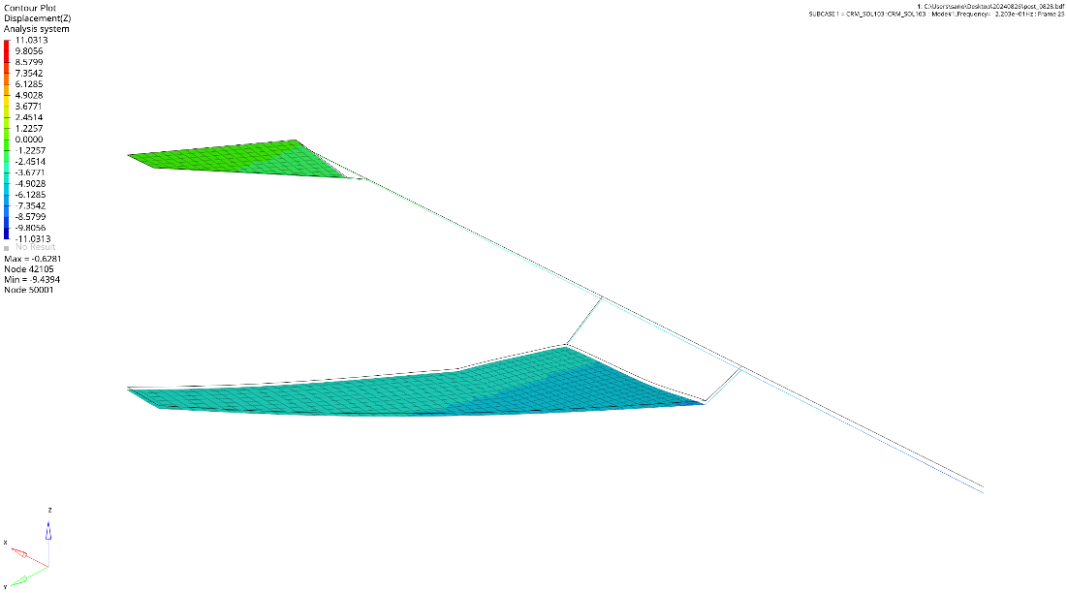
Deformation : ×1.0
MODE 1 Z-direction Deformation (22.03Hz)

Slide 6
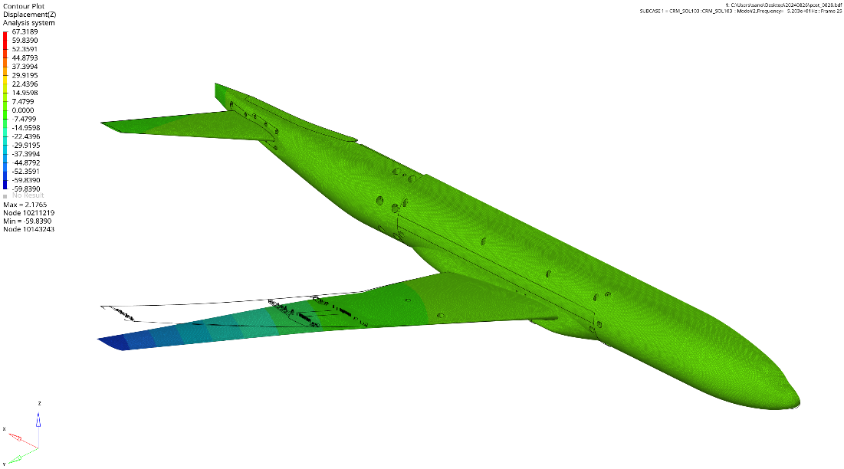
Deformation : ×1.0
MODE 2 Z-direction Deformation (52.03Hz)

Slide 7
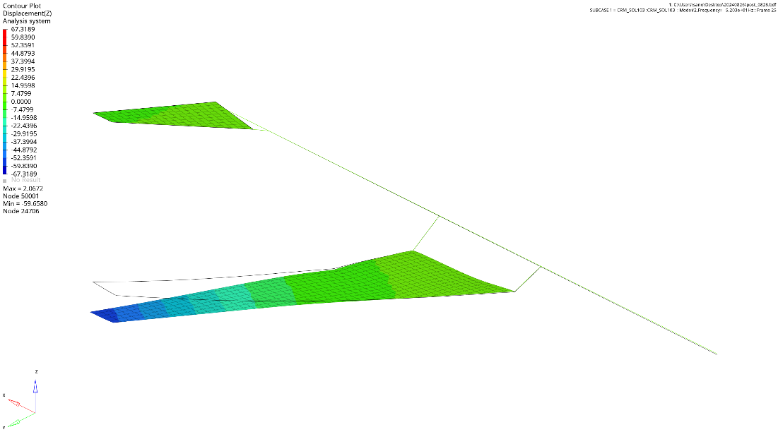
Deformation : ×1.0
MODE 2 Z-direction Deformation (52.03Hz)

Slide 8
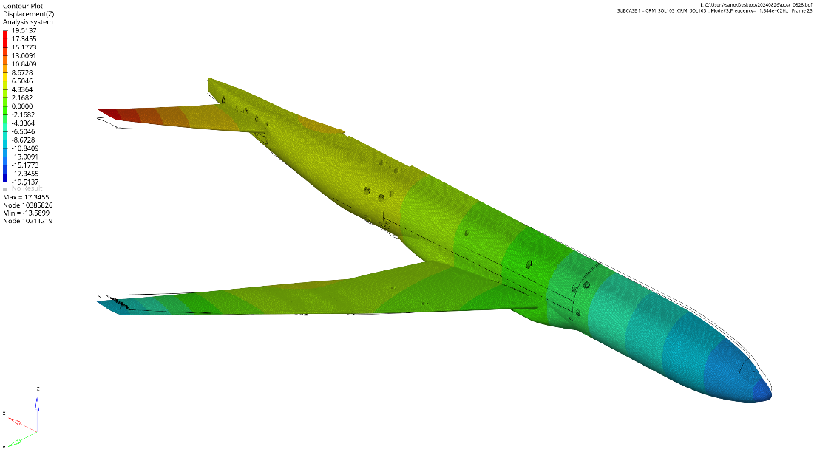
Deformation : ×1.0
MODE 3 Z-direction Deformation (134.43Hz)

Slide 9
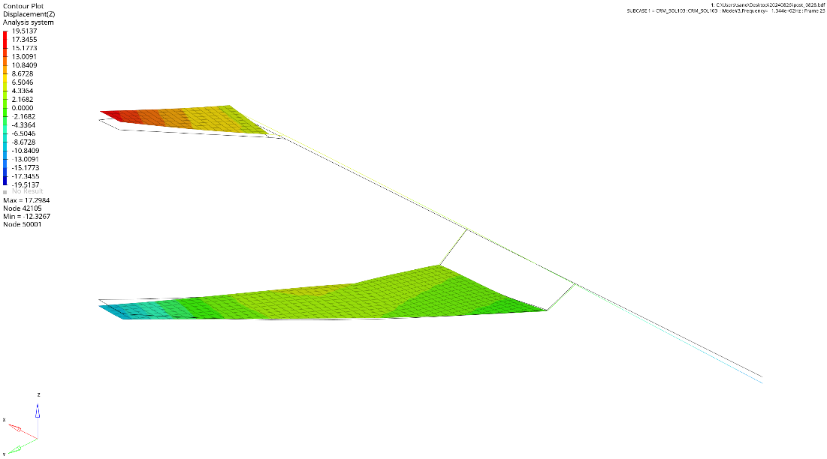
Deformation : ×1.0
MODE 3 Z-direction Deformation (134.43Hz)

Slide 10
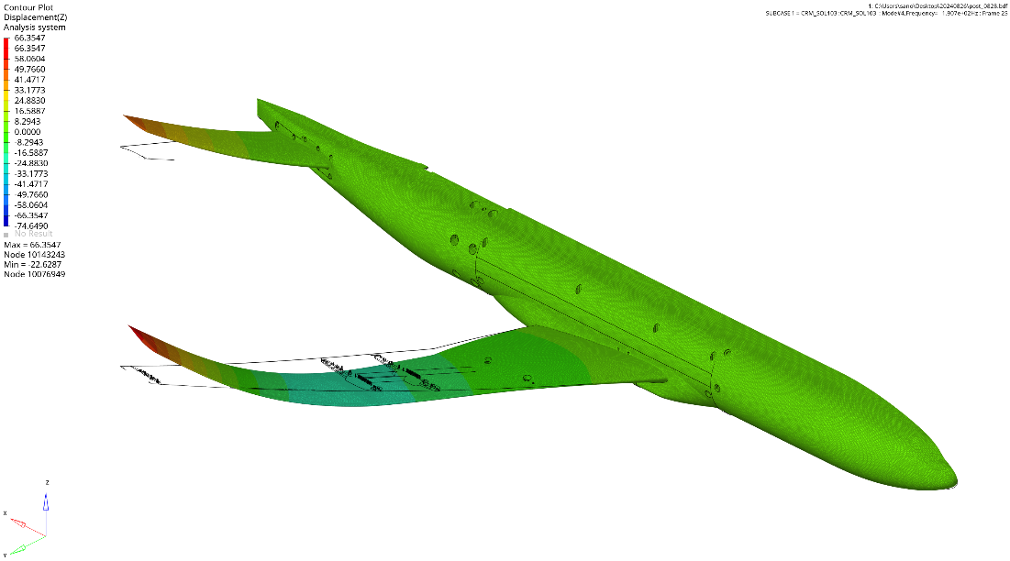
Deformation : ×1.0
MODE 4 Z-direction Deformation (190.72Hz)

Slide 11
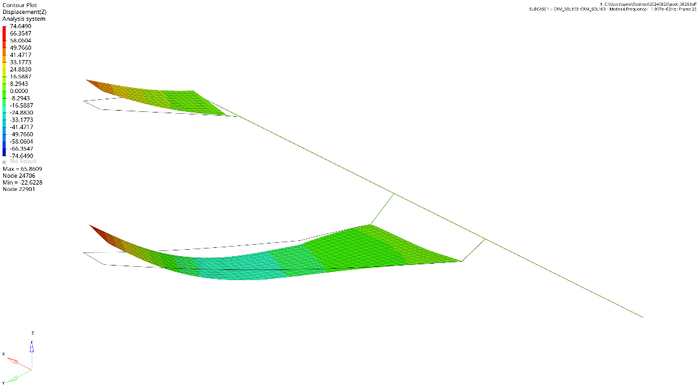
Deformation : ×1.0
MODE 4 Z-direction Deformation (190.72Hz)

Slide 12
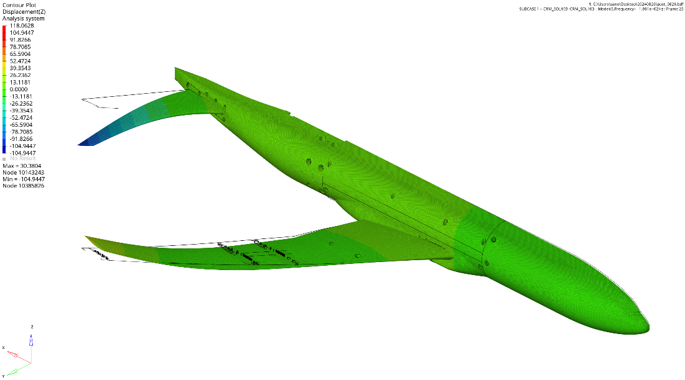
Deformation : ×1.0
MODE 5 Z-direction Deformation (198.09Hz)

Slide 13
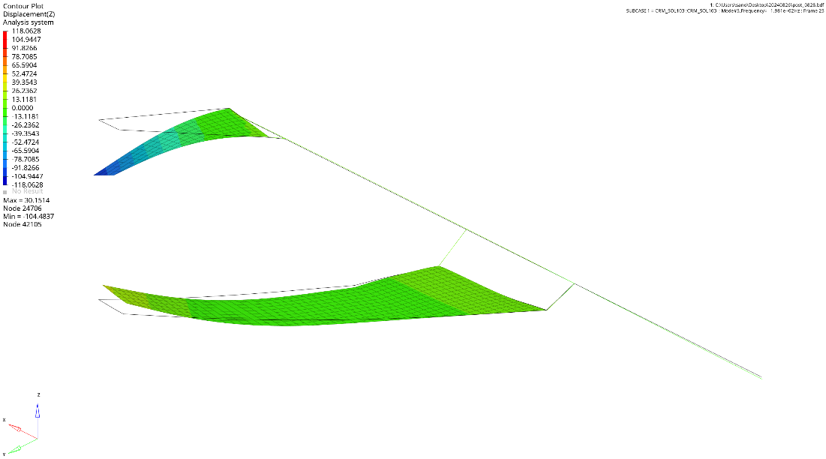
Deformation : ×1.0
MODE 5 Z-direction Deformation (198.09Hz)

Slide 14
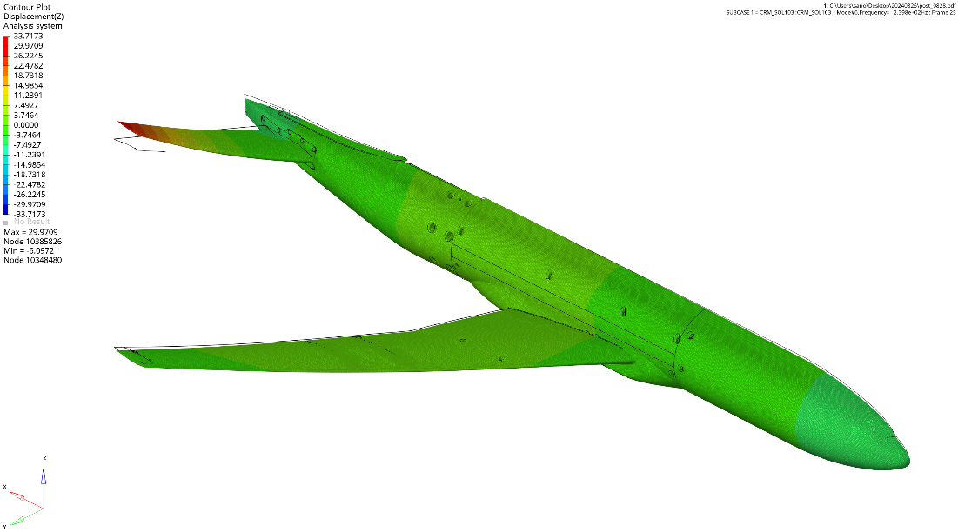
Deformation : ×1.0
MODE 6 Z-direction Deformation (239.75Hz)

Slide 15
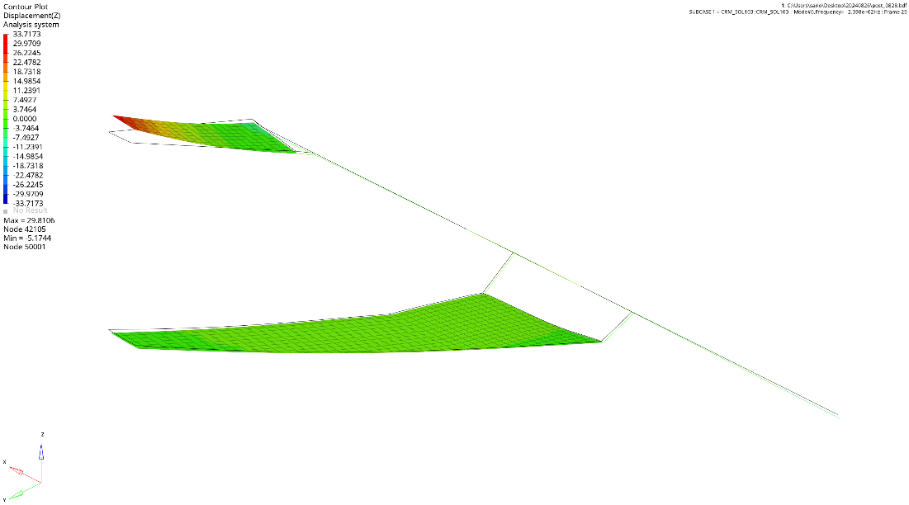
Deformation : ×1.0
MODE 6 Z-direction Deformation (239.75Hz)

Slide 16
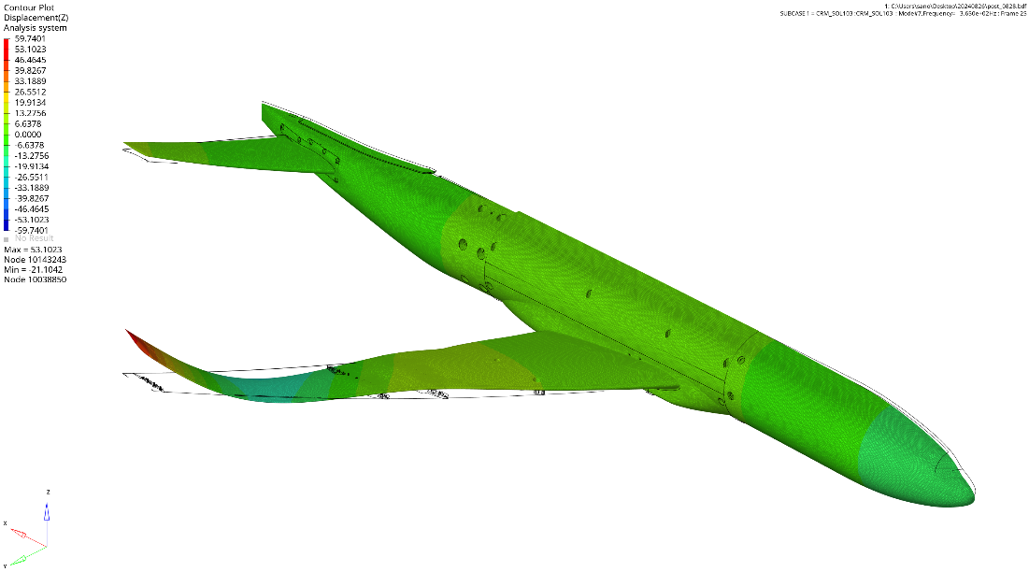
Deformation : ×1.0
MODE 7 Z-direction Deformation (365.00Hz)

Slide 17
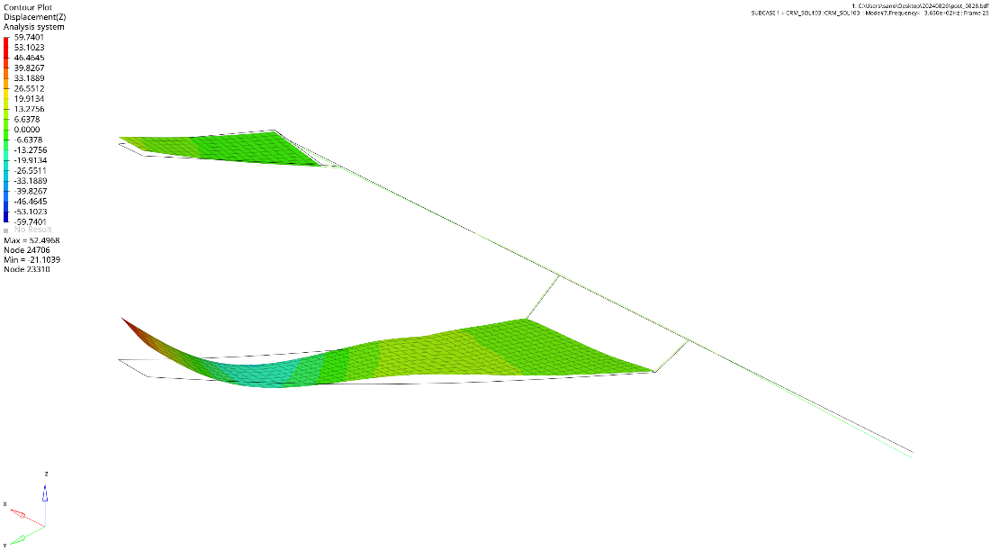
Deformation : ×1.0
MODE 7 Z-direction Deformation (365.00Hz)

Slide 18
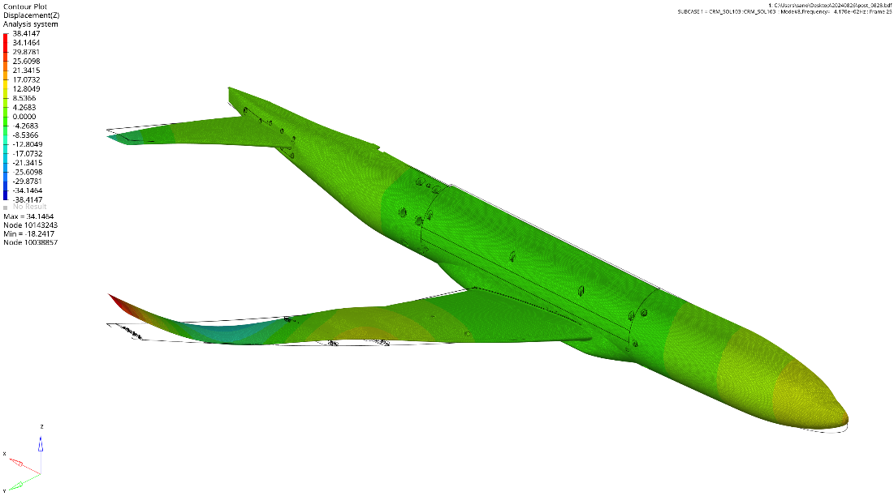
Deformation : ×1.0
MODE 8 Z-direction Deformation (417.04Hz)

Slide 19
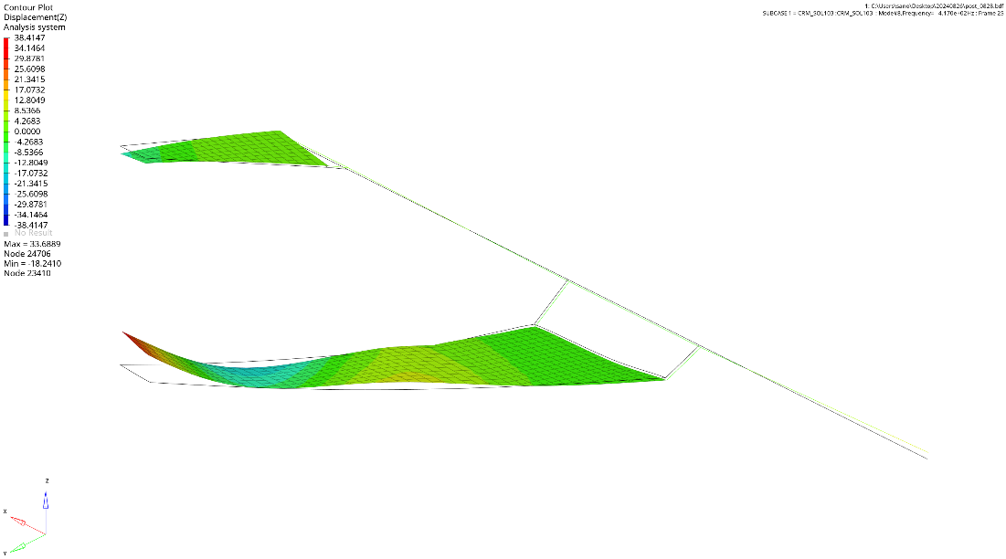
Deformation : ×1.0
MODE 8 Z-direction Deformation (417.04Hz)

Slide 20
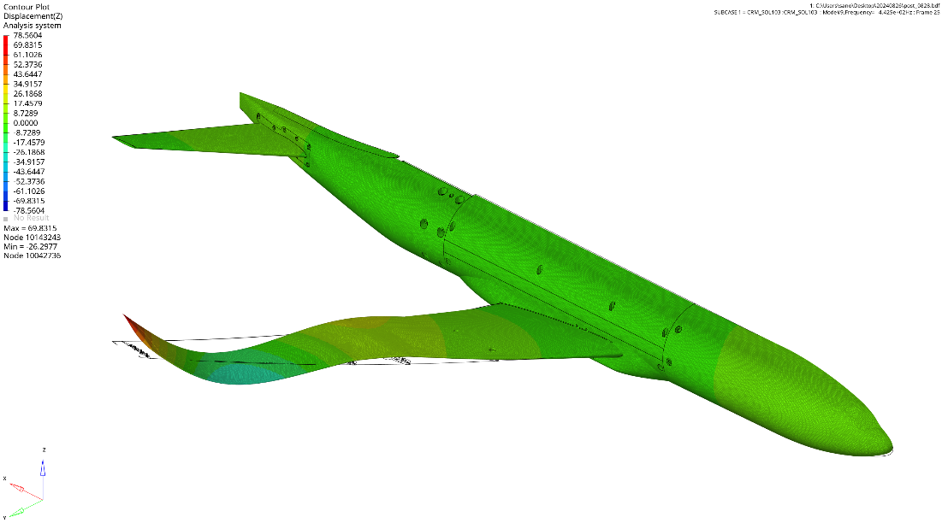
Deformation : ×1.0
MODE 9 Z-direction Deformation (442.48Hz)

Slide 21
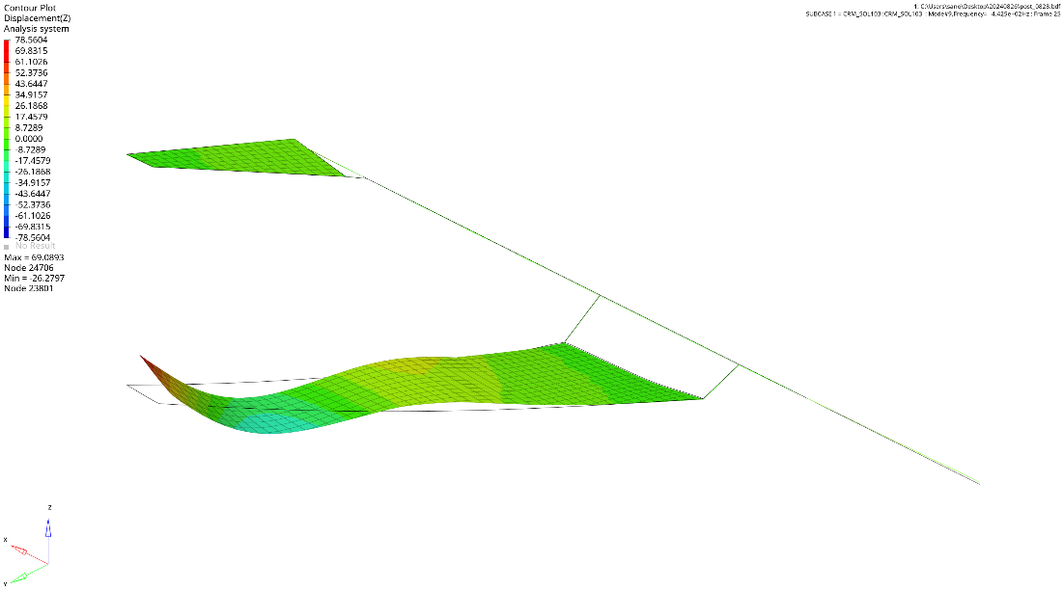
Deformation : ×1.0
MODE 9 Z-direction Deformation (442.48Hz)

Slide 22
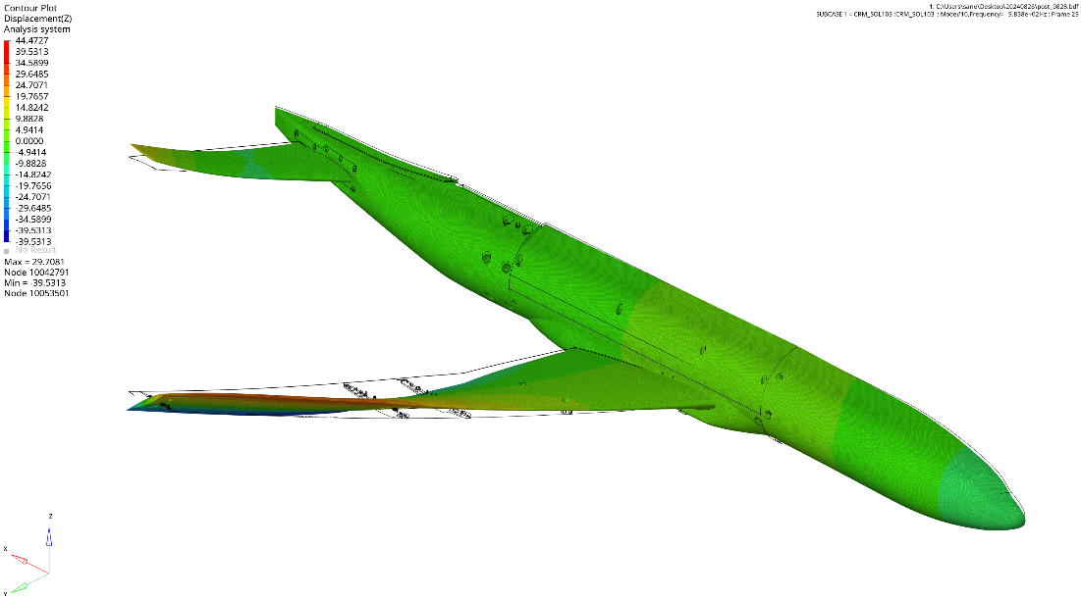
Deformation : ×1.0
MODE 10 Z-direction Deformation (583.84Hz)

Slide 23
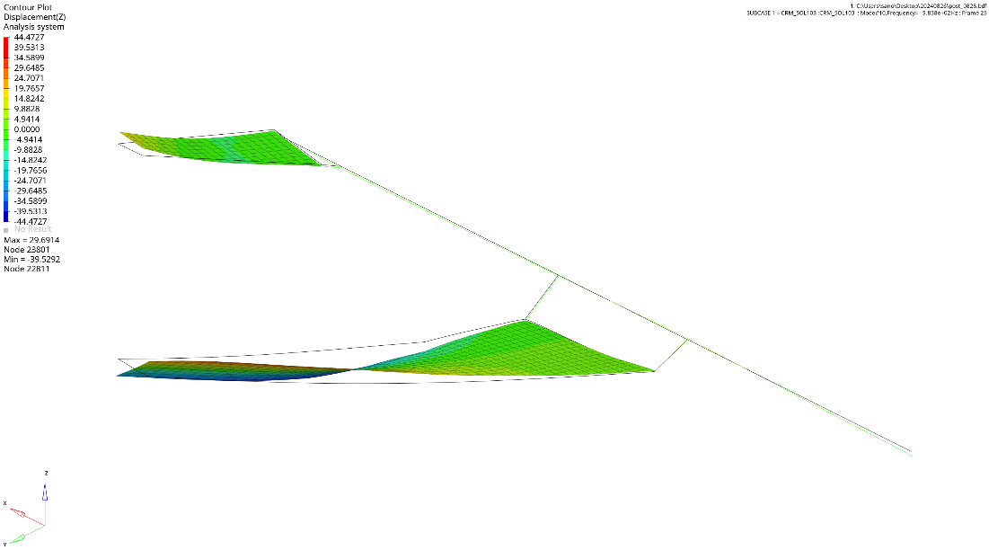
Deformation : ×1.0
MODE 10 Z-direction Deformation (583.84Hz)

